Slide 1


https://shorturl.at/yrM60

Slide 2

https://aistudio.google.com/

Slide 3


Retrieval Augmented Generation (RAG)
By Sarawoot Kongyoung
National Electronics and Computer Technology Center

Slide 4
Retrieval Augmented Generation (RAG)
Retrieval
Generation

Slide 5



Task/domain specific
dataset
Generation (LLM)
Fine-tuning
Response
Query
{ }
Pre-training
Response
Gigantic dataset
(web, wiki, books, news, etc)
LLM (Generation)
Q/A System
User

Slide 6




Task/domain specific
dataset
RAG = Retrieval + Generation (LLM)
Fine-tuning
Response
Query
{ }
Pre-training
Response
Gigantic dataset
(web, wiki, books, news, etc)
LLM (Generation)
Q/A System
User
Search
Reduce Hallucination
Query + relevant docs
Knowledge/documents
Retrieval

Slide 7
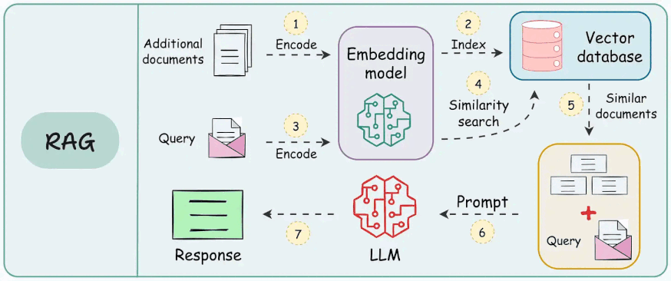
https://www.dailydoseofds.com/a-crash-course-on-building-rag-systems-part-2-with-implementations/

Slide 8
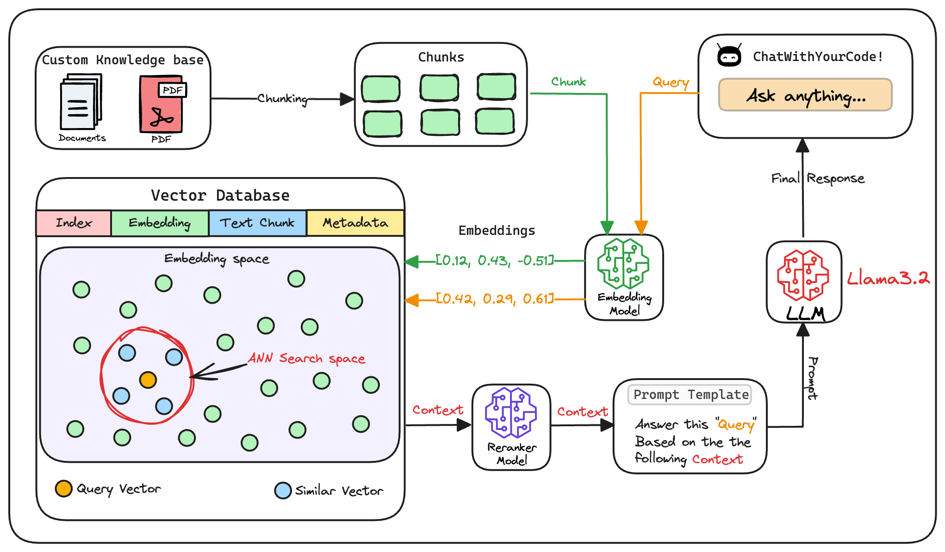
https://www.dailydoseofds.com/a-crash-course-on-building-rag-systems-part-2-with-implementations/

Slide 9
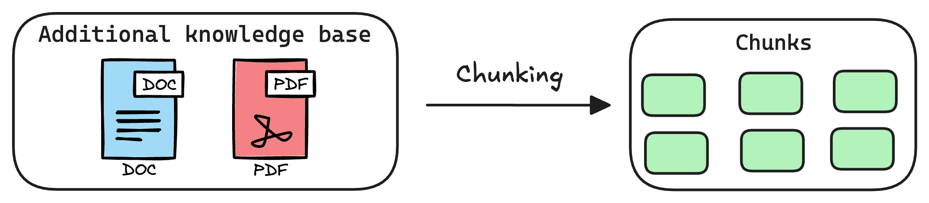
1. Create chunks
https://www.dailydoseofds.com/a-crash-course-on-building-rag-systems-part-2-with-implementations/

Slide 10
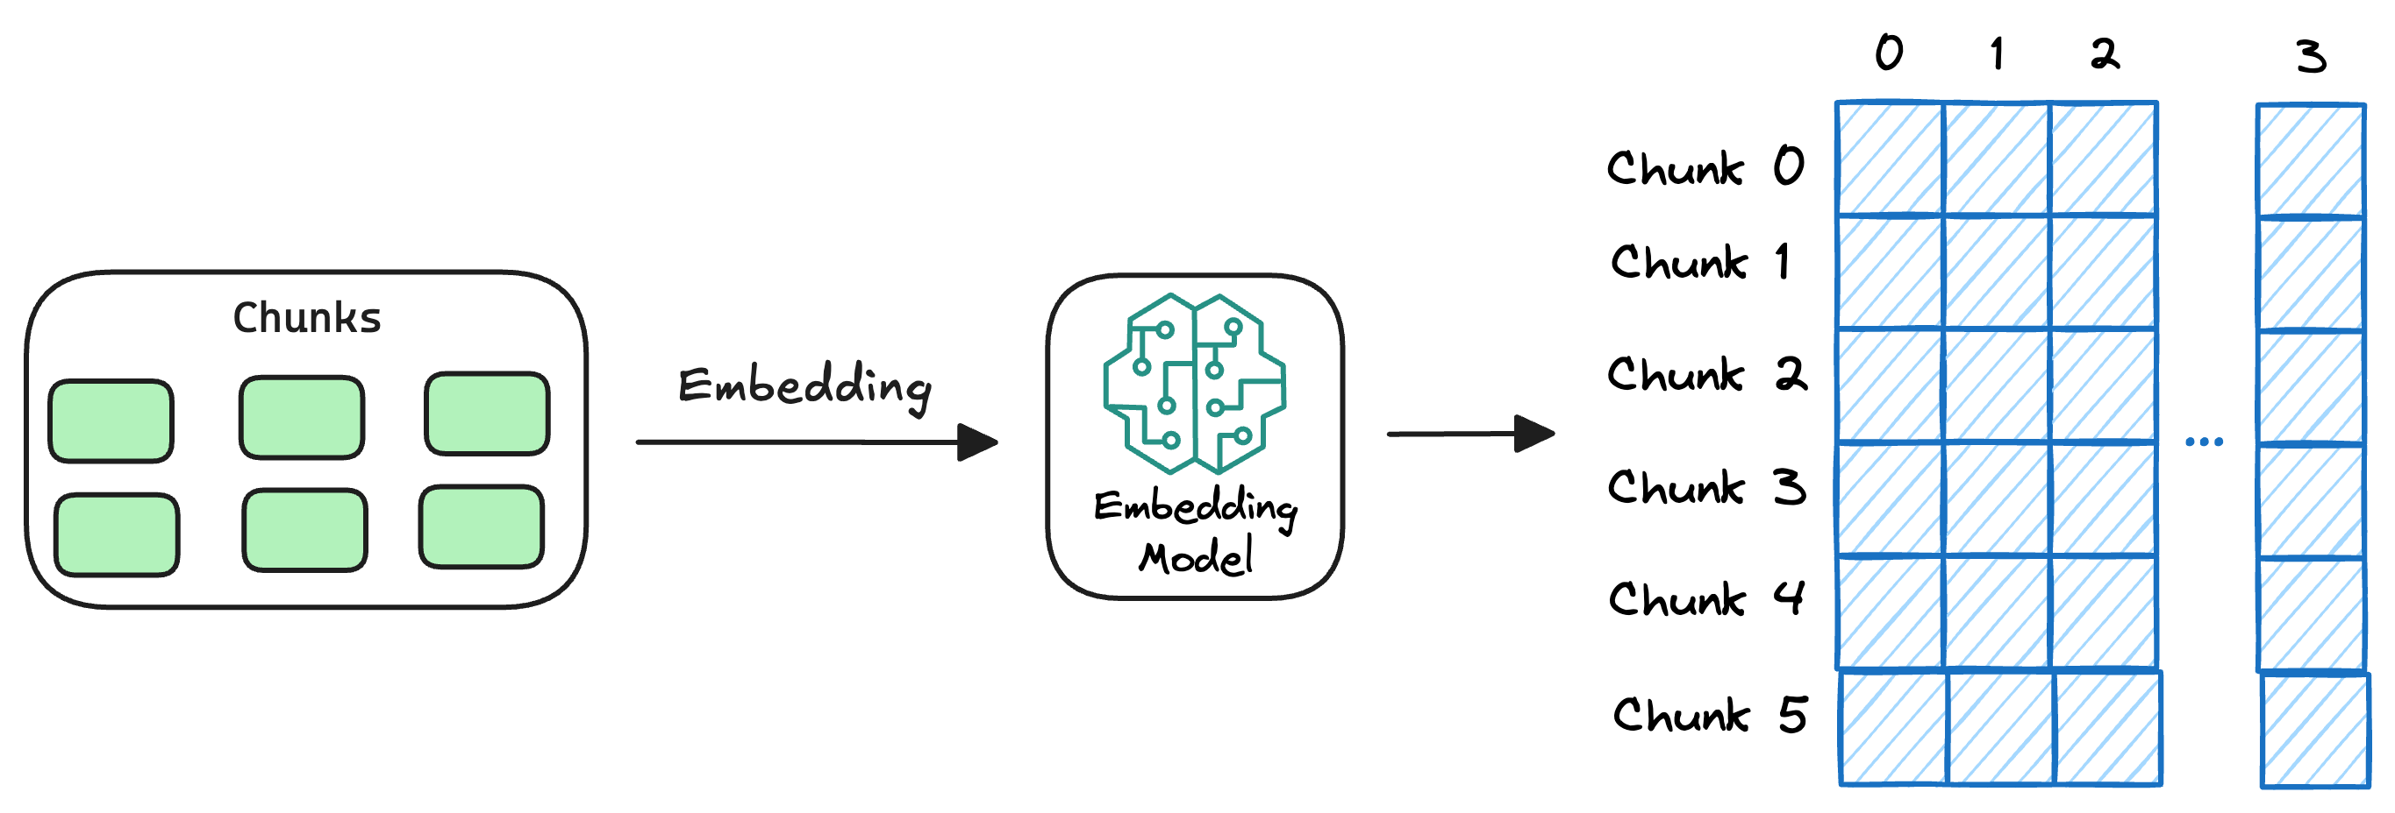
2. Generate embeddings
https://www.dailydoseofds.com/a-crash-course-on-building-rag-systems-part-2-with-implementations/

Slide 11
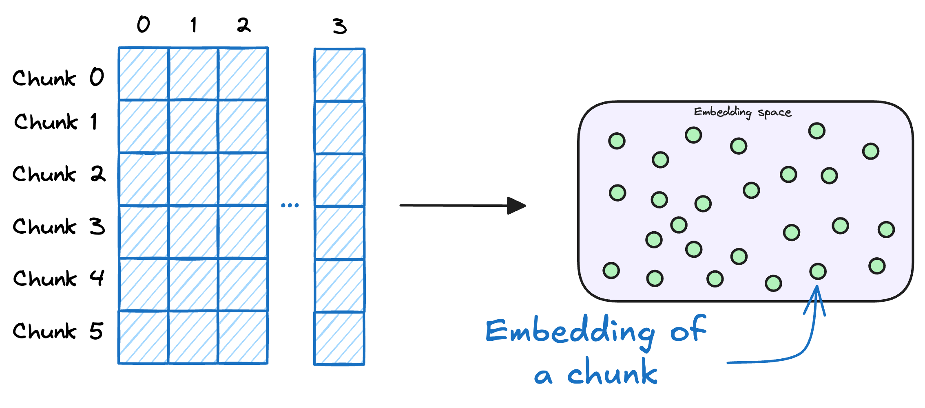
3. Store embeddings in a vector database
https://www.dailydoseofds.com/a-crash-course-on-building-rag-systems-part-2-with-implementations/

Slide 12
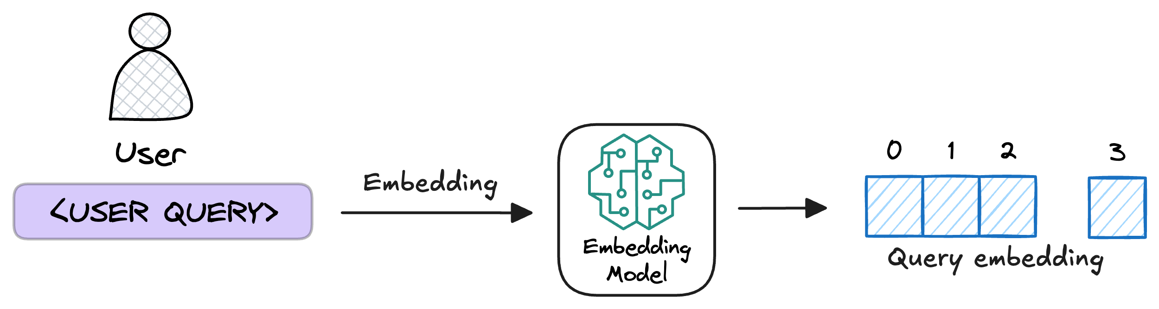
4. Embed the query
https://www.dailydoseofds.com/a-crash-course-on-building-rag-systems-part-2-with-implementations/

Slide 13
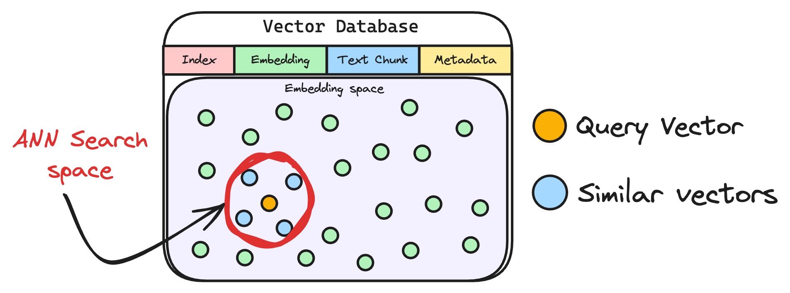
5. Retrieve similar chunks
https://www.dailydoseofds.com/a-crash-course-on-building-rag-systems-part-2-with-implementations/

Slide 14
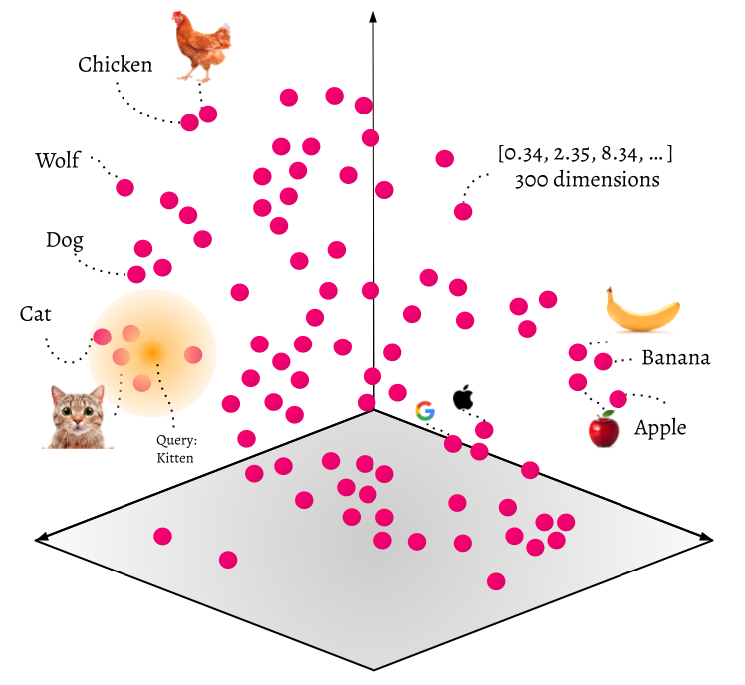
https://odsc.medium.com/getting-started-with-vector-based-search-23c22da43266

Slide 15
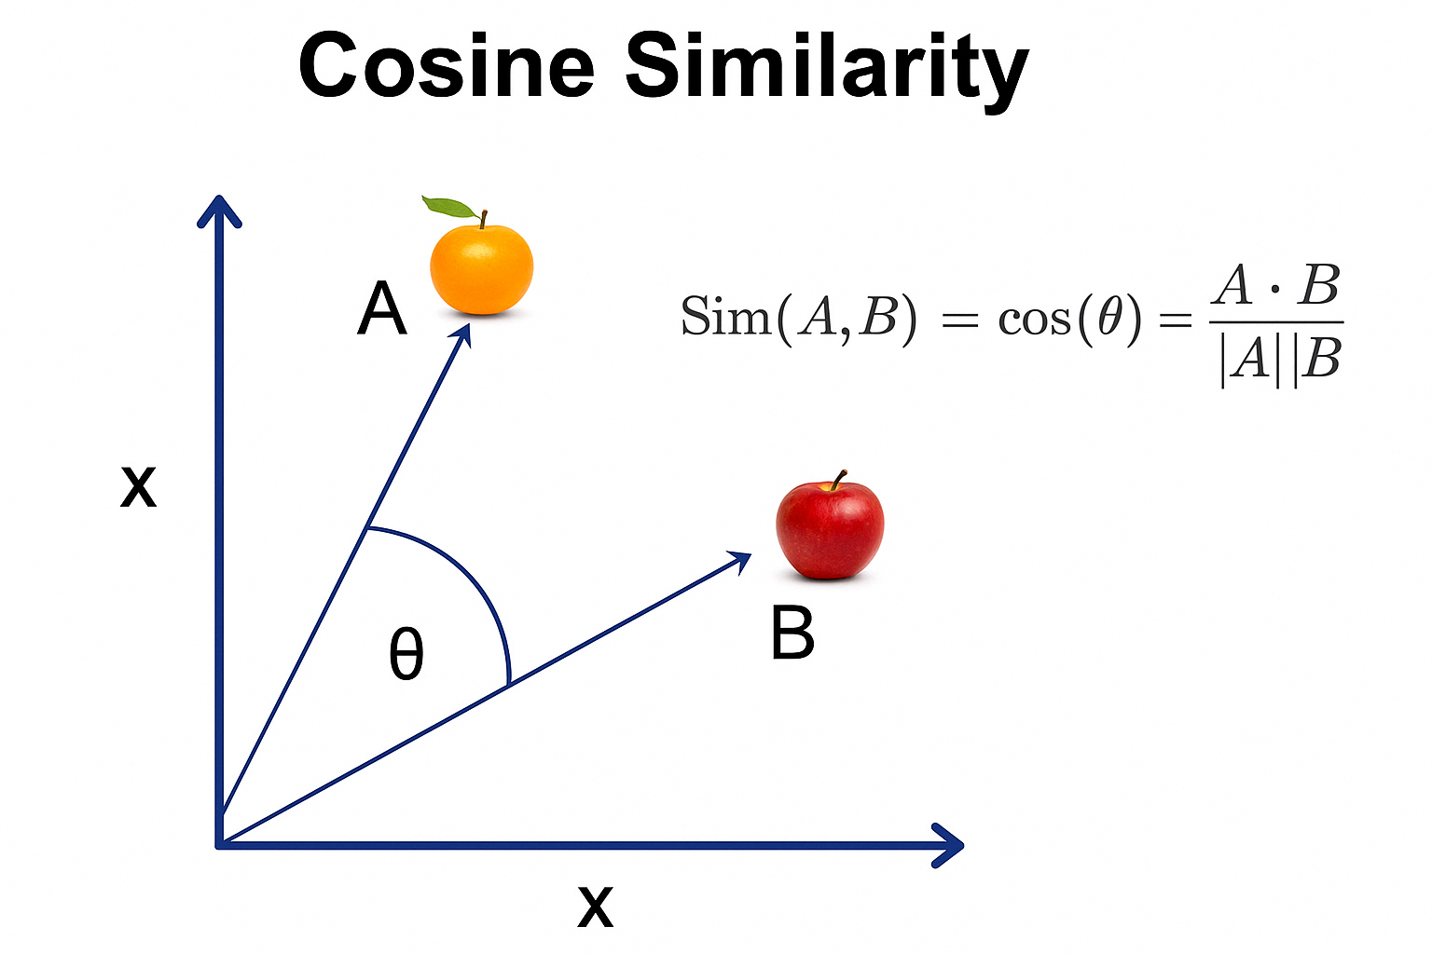
|
https://businessanalytics.substack.com/p/cosine-similarity-explained

Slide 16
RAG: Retrieval Augmented Generation
Retrieval (Dense)
Input
Query
Encoder
Generator
Documents
Prompt
Output
Doc
Encoder
Retriever
Context
Vector Index

Slide 17
RAG: Retrieval Augmented Generation
Generation (LLM)
Input
Query
Encoder
Generator
Documents
Prompt
Output
Doc
Encoder
Retriever
Context
Vector Index

Slide 18
RAG: Retrieval Augmented Generation
How to encode queries?
How to chunk?
Input
Query
Encoder
Generator (LLM)
Documents
Prompt
Output
When to retrieve?
Doc
Encoder
Retriever
Context
How to encode docs?
How and what do I retrieve?
Vector Index

Slide 19
RAG: Retrieval Augmented Generation
How to pre-process?
Input
Query
Encoder
Generator (LLM)
Documents
How to verify?
How to prompt?
Prompt
Output
How to pass context
Doc
Encoder
How to post-process?
Retriever
Context
Vector Index

Slide 20
Retrieval
How to encode queries?
Query
Encoder
Documents
Doc
Encoder
Retriever
How to encode docs?
Vector Index

Slide 21
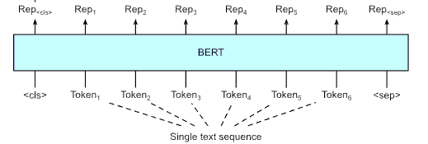
768
768
768
768
768
Source:https://d2l.ai/chapter_natural-language-processing-applications/finetuning-bert.html

Slide 22
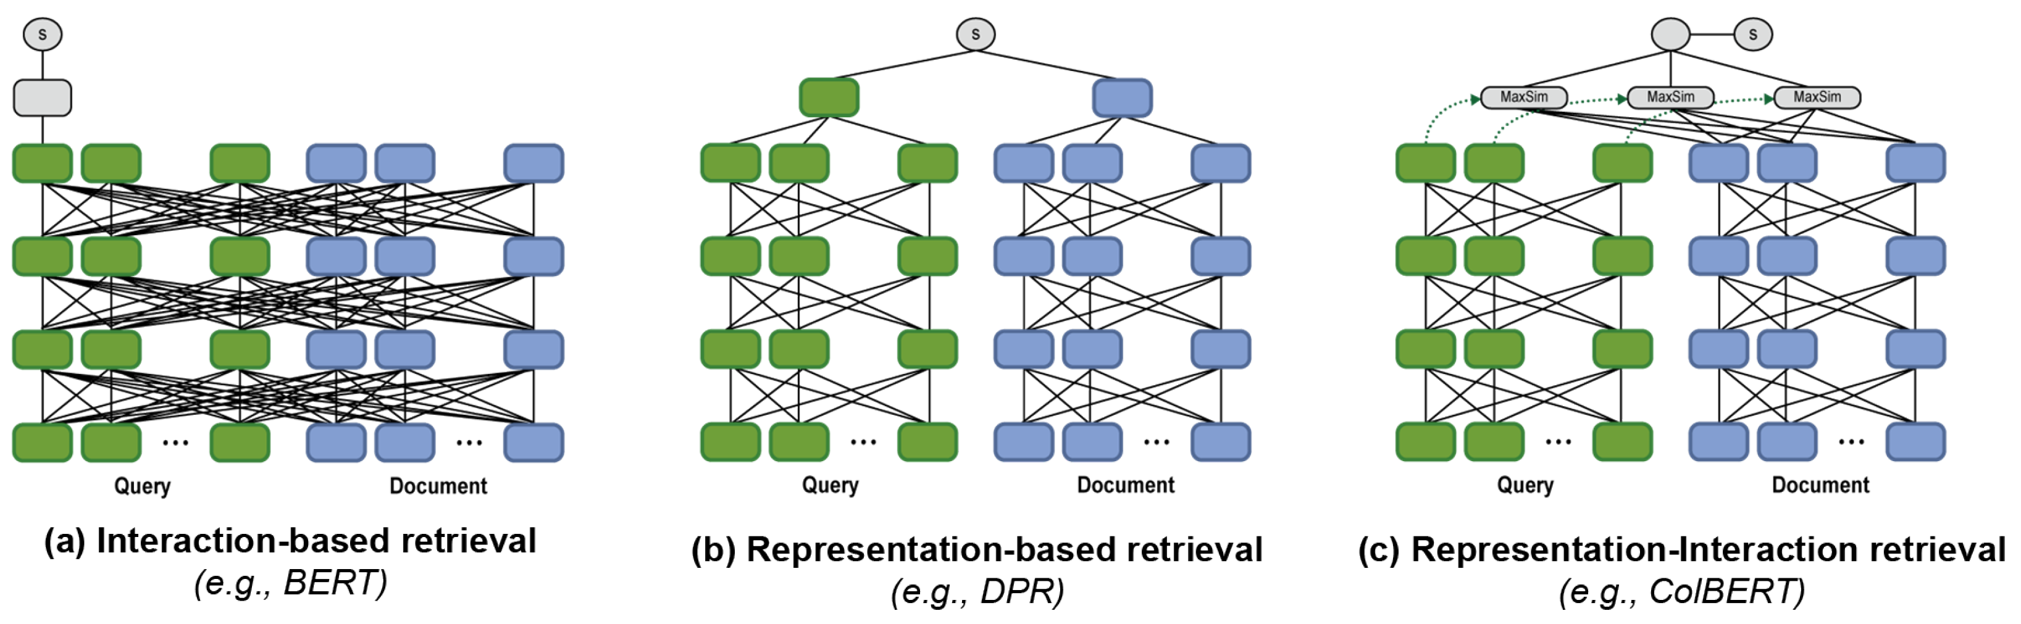
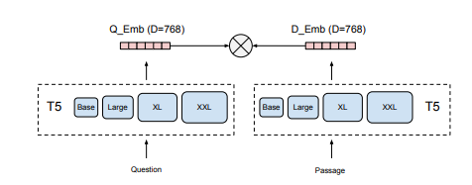
Dense Retrieval

Slide 23
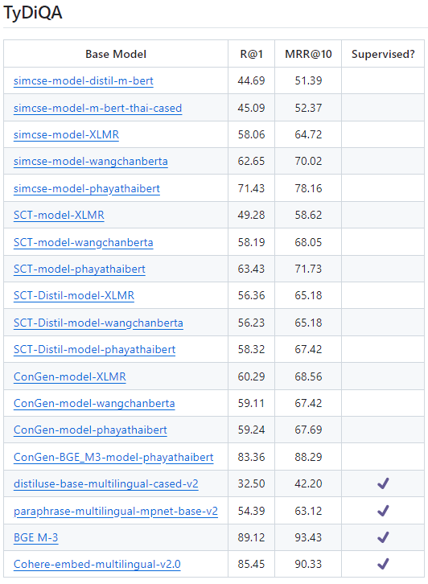
Dense Retrieval for Thai?
https://github.com/mrpeerat/Thai-Sentence-Vector-Benchmark

Slide 24
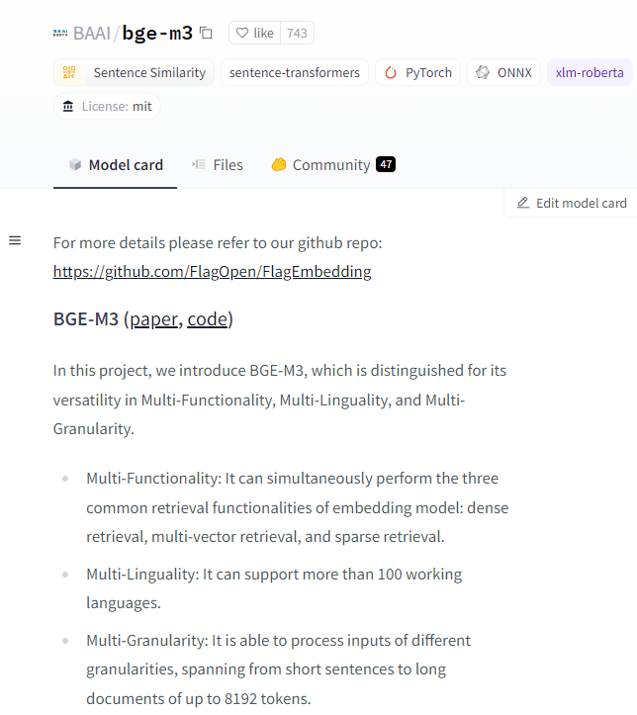
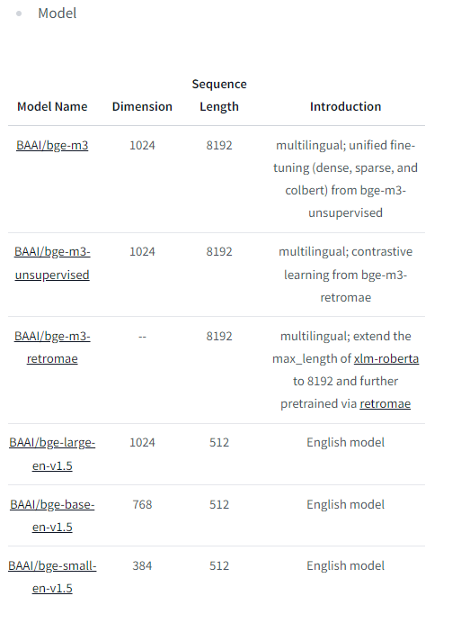
https://huggingface.co/BAAI/bge-m3

Slide 25
Huggingface download model
pip install hf_transfer
export HF_HUB_ENABLE_HF_TRANSFER=1
huggingface-cli download <model-name> --local-dir <model-dir>

Slide 26
Retrieval
Query
Encoder
How to chunk?
Documents
Doc
Encoder
Retriever
Vector Index

Slide 27
https://github.com/9meo/RAG-for-SuperAI/

Slide 28
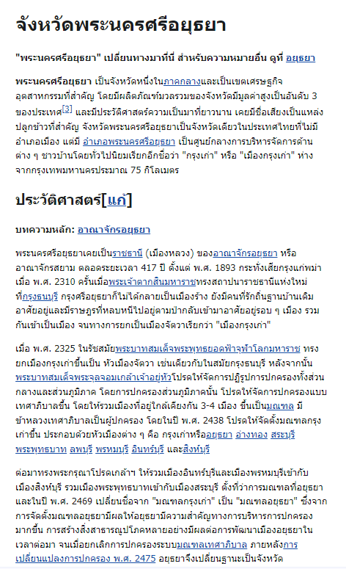
BERT

Slide 29
BAAI/bge-m3
[0.016539733856916428, 0.03937997296452522,
-0.010712525807321072, -0.02129676751792431,
-0.025445323437452316]

Slide 30
Encoder
[0.005539661273360252, 0.015187489800155163,
-0.01164360623806715,
-0.01728619821369648,
-0.021985329687595367]
[0.01168364193290472, 0.04119976609945297,
-0.00417240709066391,
-0.02726016566157341,
-0.03603764623403549]
[0.031089192256331444, 0.04272811487317085,
-0.00500113982707262, 0.0019403527257964015, -0.01635820046067238]
[0.021662477403879166, 0.04273651912808418, 0.01920708455145359, 0.007724749855697155, -0.007433386519551277]

Slide 31
Retrieval
Query
Encoder
Documents
Doc
Encoder
Retriever
How and what do I retrieve?
Vector Index

Slide 32
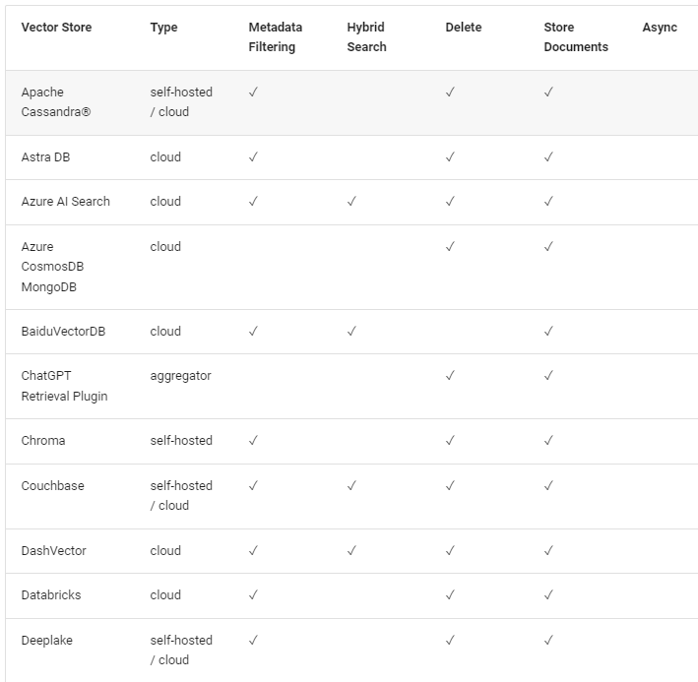
Vector Database
https://docs.llamaindex.ai/en/stable/module_guides/storing/vector_stores/#vector-store-options--feature-support

Slide 33
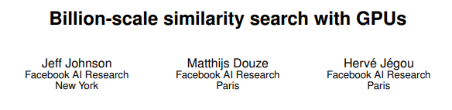
FAISS
Based on “semantic similarity” (i.e., cosine score between embeddings)
https://github.com/facebookresearch/faiss

Slide 34
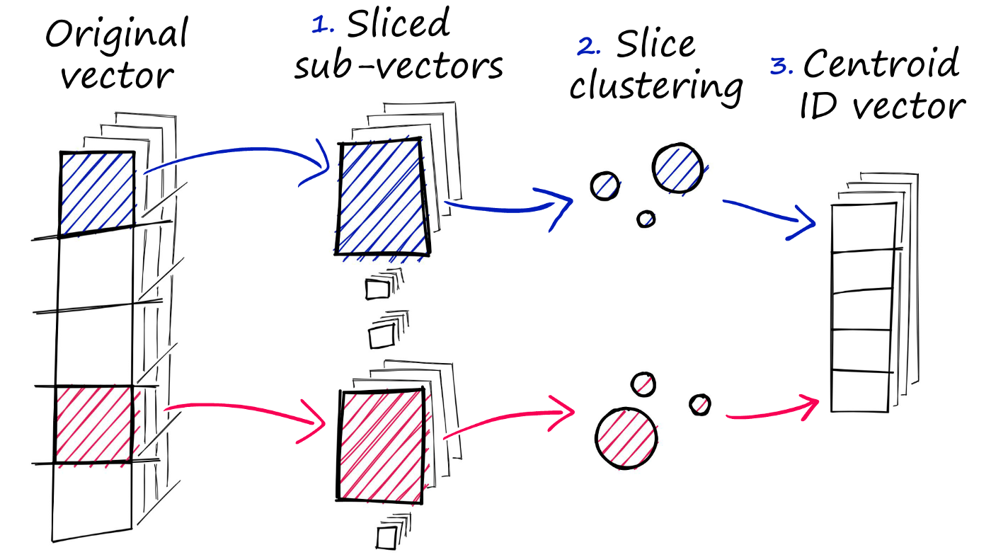
FAISS
Three steps of product quantization
https://www.pinecone.io/learn/series/faiss/faiss-tutorial/

Slide 35
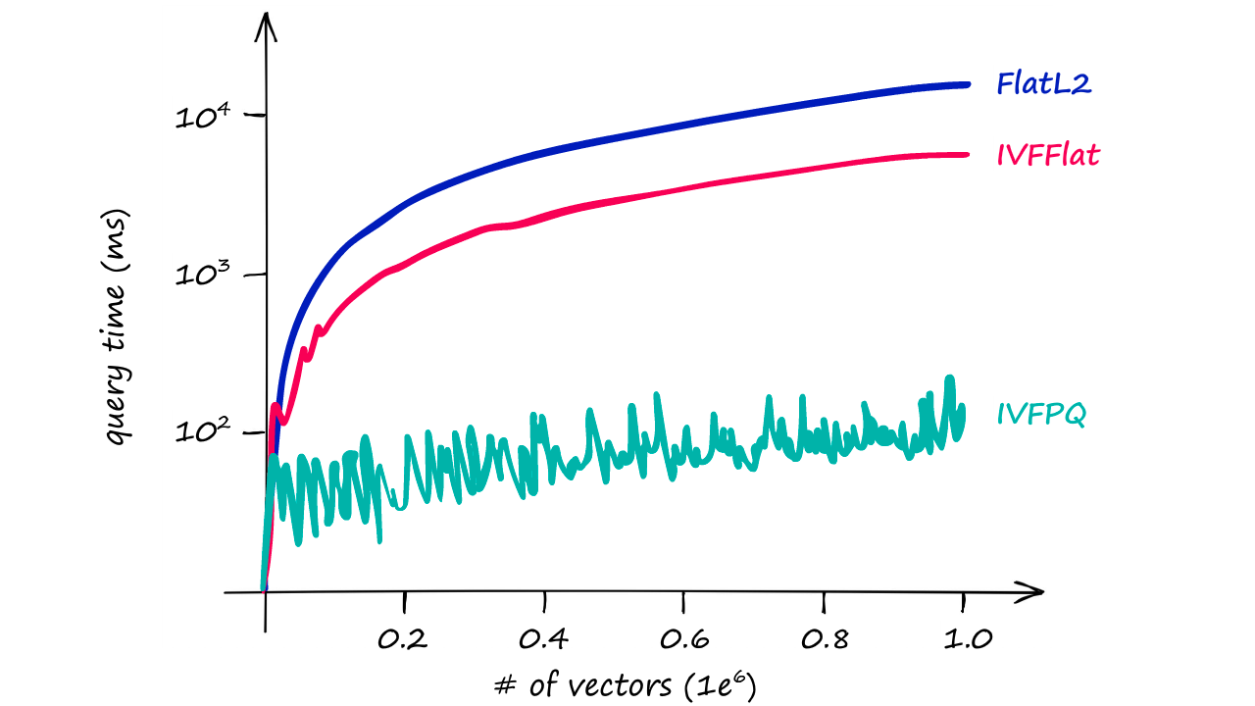
FAISS
Query time / number of vectors for the three indexes
https://www.pinecone.io/learn/series/faiss/faiss-tutorial/
Notes:
https://www.pinecone.io/learn/series/faiss/faiss-tutorial/

Slide 36
Retrieval
Query
Encoder
Documents
When to retrieve?
Doc
Encoder
Retriever
How and what do I retrieve?
Vector Index

Slide 37
Generation (LLM)
Input
Generator (LLM)
Prompt
Output
Context

Slide 38
https://openrouter.ai/
https://ngrok.com/

Slide 39
google authenticator chrome extension

Slide 40
llama.cpp
https://github.com/ggerganov/llama.cpp
Inference of Meta's LLaMA model (and others) in pure C/C++
https://github.com/abetlen/llama-cpp-python
Python Bindings for llama.cpp

Slide 41
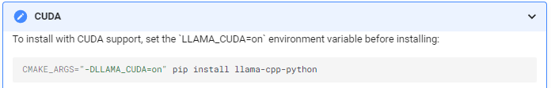
Install llama.cpp
https://llama-cpp-python.readthedocs.io/en/stable/
Use CuBLAS if you have CUDA and an NVidia GPU
Use METAL if you are running on an M1/M2 MacBook
Use CLBLAST if you are running on an AMD/Intel GPU

Slide 42
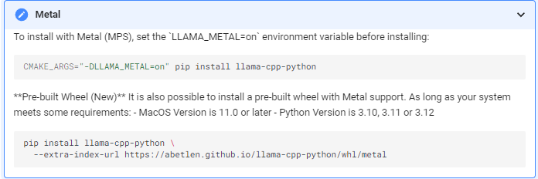
Install llama.cpp
https://llama-cpp-python.readthedocs.io/en/stable/
Use CuBLAS if you have CUDA and an NVidia GPU
Use METAL if you are running on an M1/M2 MacBook
Use CLBLAST if you are running on an AMD/Intel GPU

Slide 43
llama.cpp (https://github.com/ggerganov/llama.cpp)
git clone https://github.com/ggerganov/llama.cpp.git
cd llama.cpp
make
Try:
./main -m <path to model>/openthaigpt-Q4_K_M.gguf -p "Building a website can be done in 10 simple steps:\nStep 1:" -n 400 –e
./main -m <path to model>/openthaigpt-Q4_K_M.gguf -p "สูตรทำส้มตำปูปลาร้าใน 10 ขั้นตอน\n ขั้นตอนที่ 1:" -n 400 -e

Slide 44
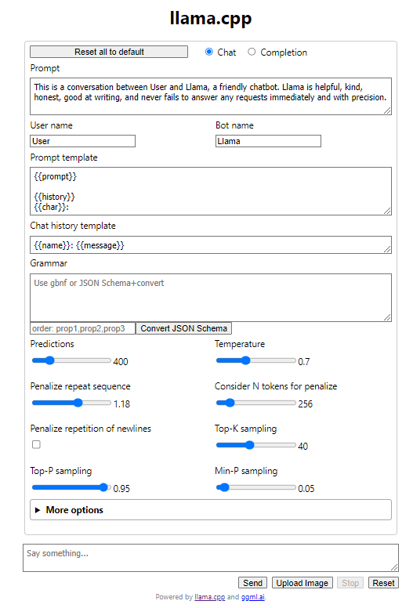
llama.cpp
./server –m <path to model>/openthaigpt-Q4_K_M.gguf
Go to: 127.0.0.1:8080

Slide 45
Generation (LLM)
How to pre-process?
Input
Generator (LLM)
How to verify?
How to prompt?
Prompt
Output
How to pass context
How to post-process?
Context

Slide 46
Generation (LLM)
Input
Generator (LLM)
How to prompt?
Prompt
Output
Context

Slide 47
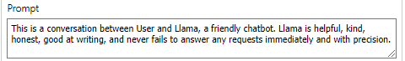
How to prompt?
OpenThaiGPT
You are a question answering assistant. Answer the question as truthful and helpful as possible คุณคือผู้ช่วยตอบคำถาม จงตอบคำถามอย่างถูกต้องและมีประโยชน์ที่สุด

Slide 48
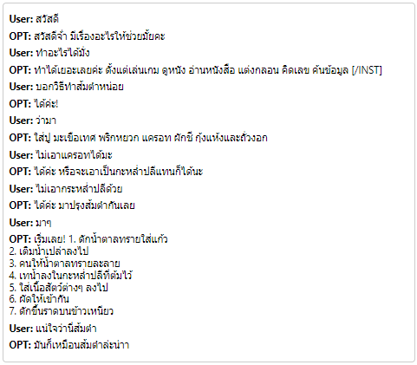
Chat

Slide 49
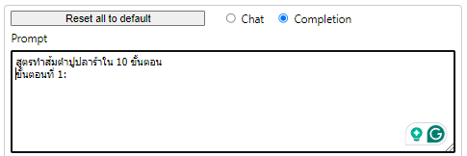
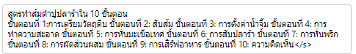
Completion

Slide 50
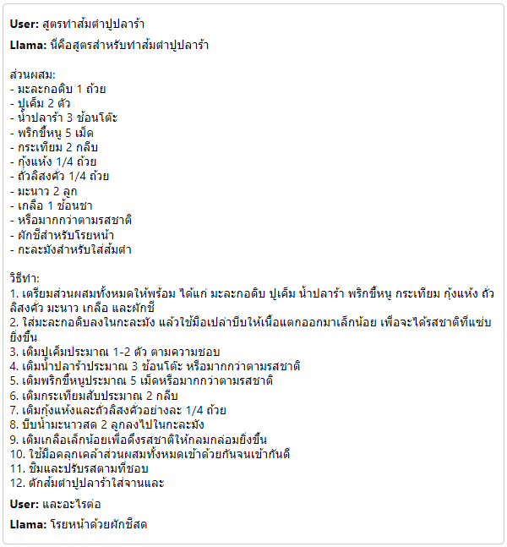
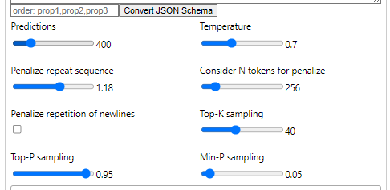
Parameters

Slide 51
RAG: Retrieval Augmented Generation
Input
Query
Encoder
Generator
Documents
Prompt
Output
Doc
Encoder
Retriever
Context
Vector Index

Slide 52

https://s3t.abdul.in.th/ai-literacy

